Slide 1
Low-Pressure IMS Construction: Drift Region Construction
Clowers Research Group at WSU

Slide 2
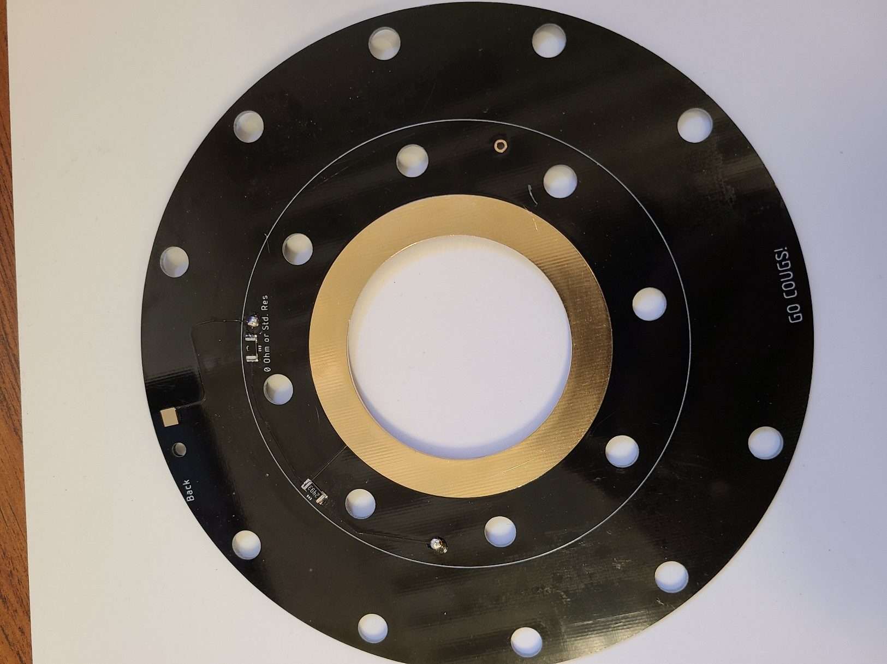
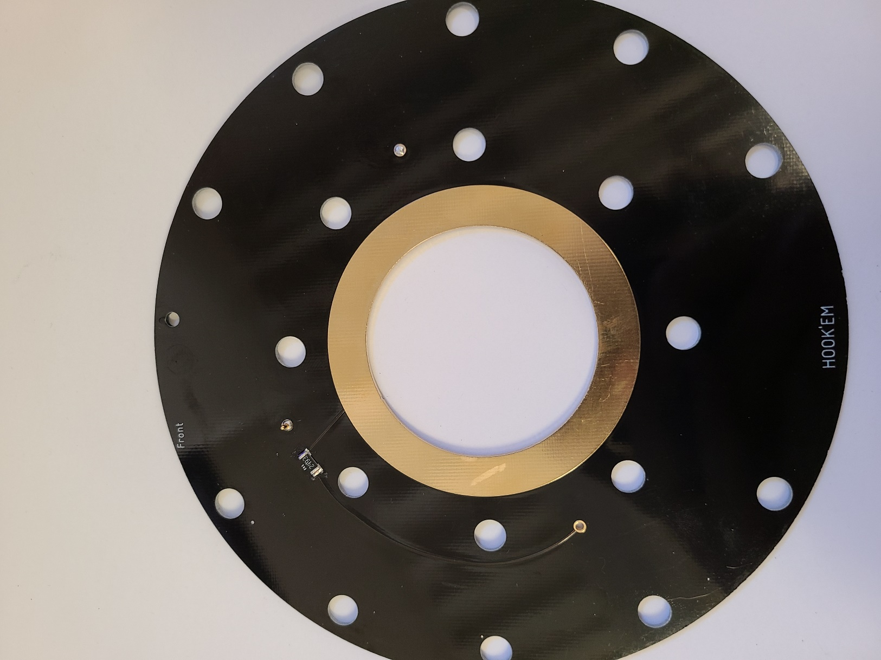
PCB Flange Construction
Both resistors are 250 kΩ except the labeled spot which is for a 0 Ω resistor (Red Circle)
POGO pins are used to make contact with the drift regions. Ensure proper electrical connection. (Blue Circle)
POGO pin needs to be placed on the first drift ring for the first drift region (in order to properly seal).
PCB flange may need to be reversed depending on orientations of drift regions. Ensure that 500 kΩ is measured from POGO pin in to POGO pin out if changing orientations

Slide 3
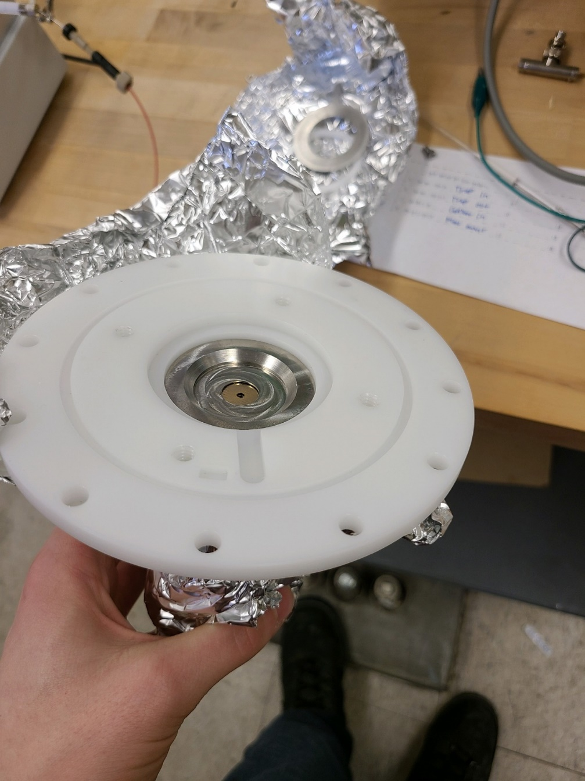
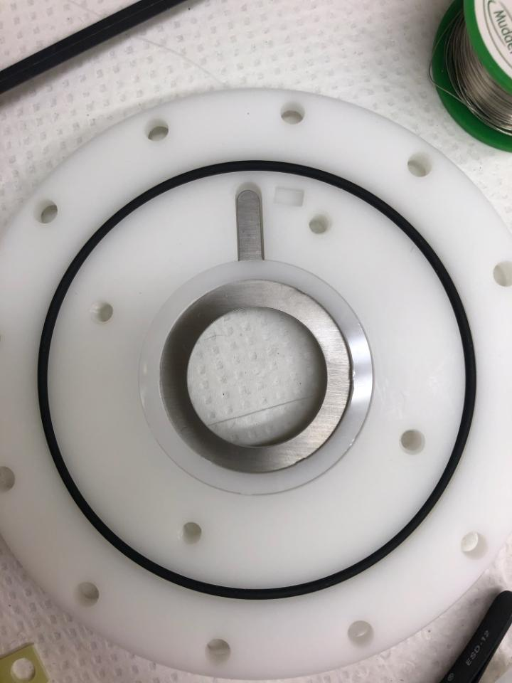
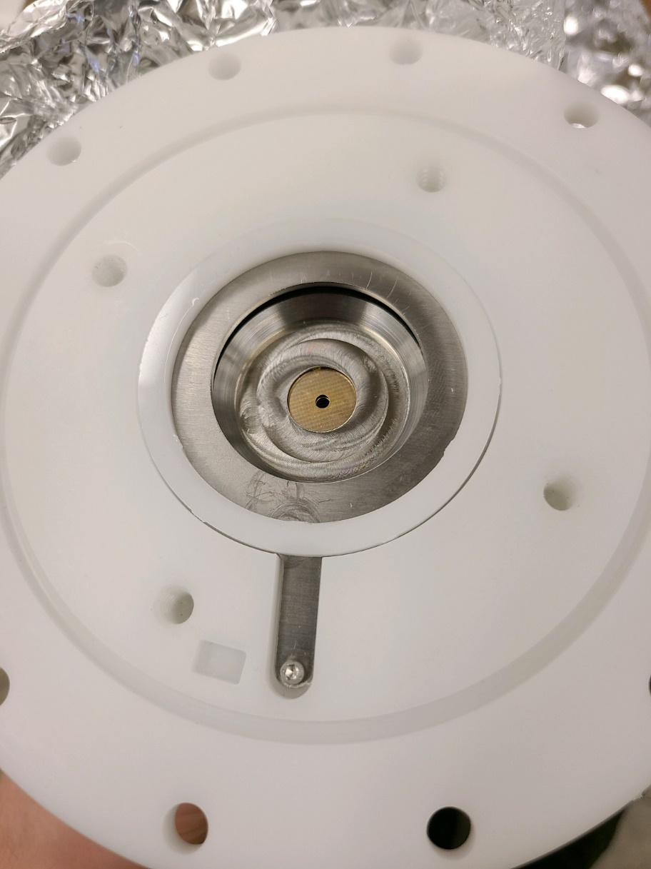
Drift Tube Region 1
The first drift region is distinct because of the mounting plate for utilization with front ion funnel.
A Delrin insert was machined in order to lay flush with the metal ring to keep it in place.
The PCB ion flange has a pogo pin which is not long enough to make contact with the metal ring. A threaded hole (No. 2) must be bored through this metal ring tab, and after threading a grinder was used to make the screw flush with the back of metal ring

Slide 4
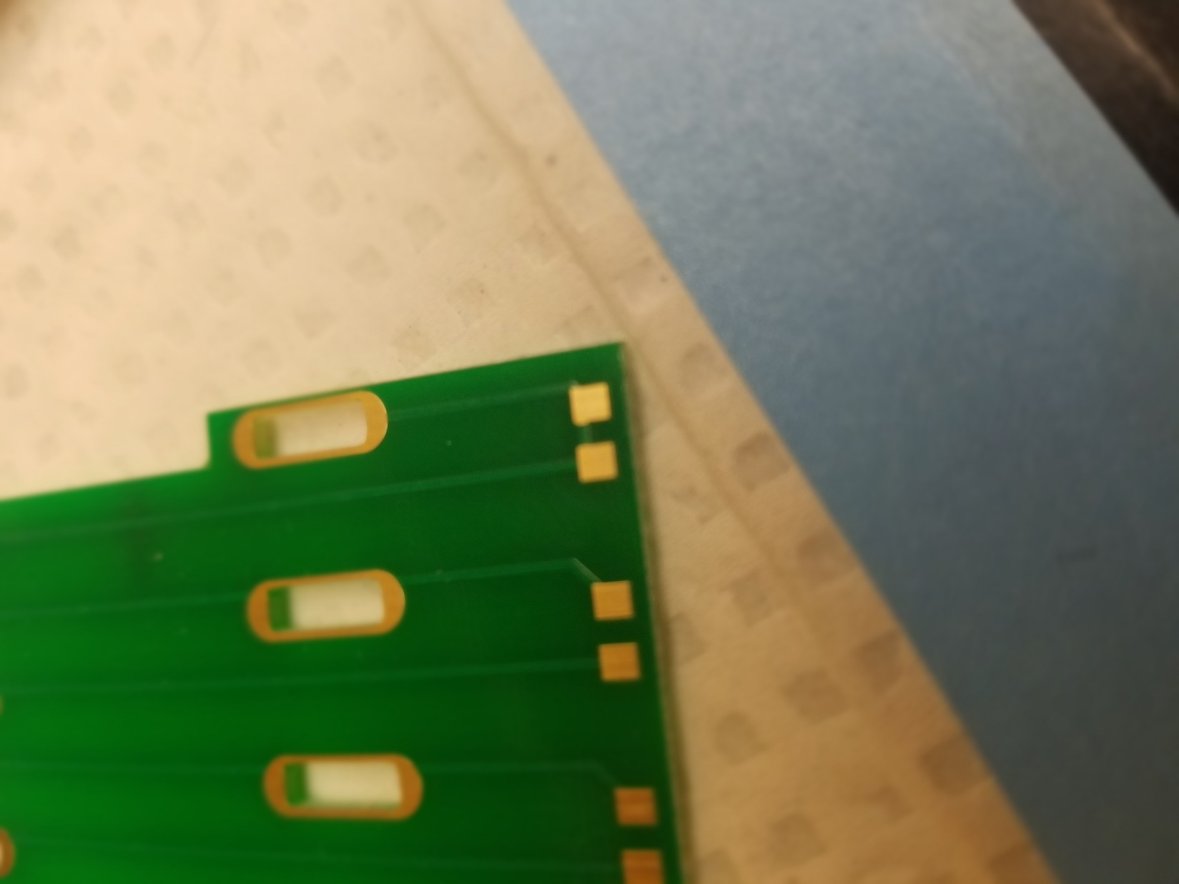
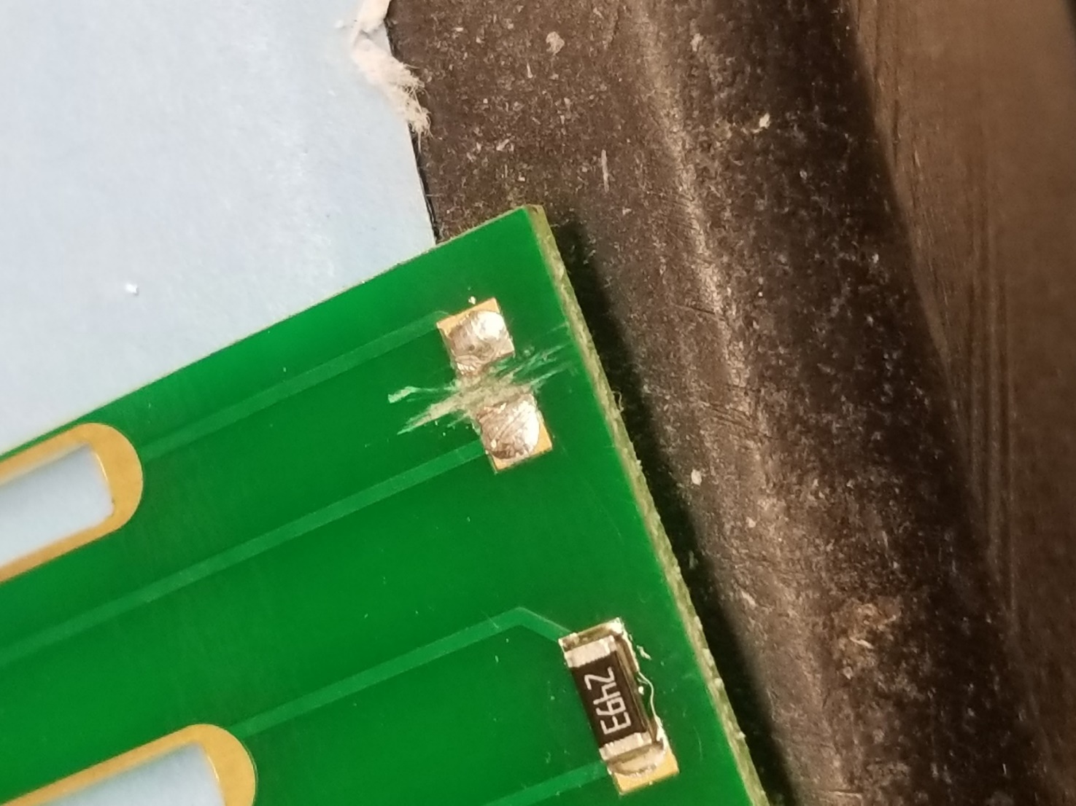
Drift Tube Construction
WARNING: Depending on which DC top boards used, there was a flaw where an extra electrical connection was made. Use a razor blade and file to remove the connection or order new boards without the flaw
Ensure all exposed metal is removed after breaking connection
THE NEW BOARDS DO NOT HAVE THIS ISSUE

Slide 5
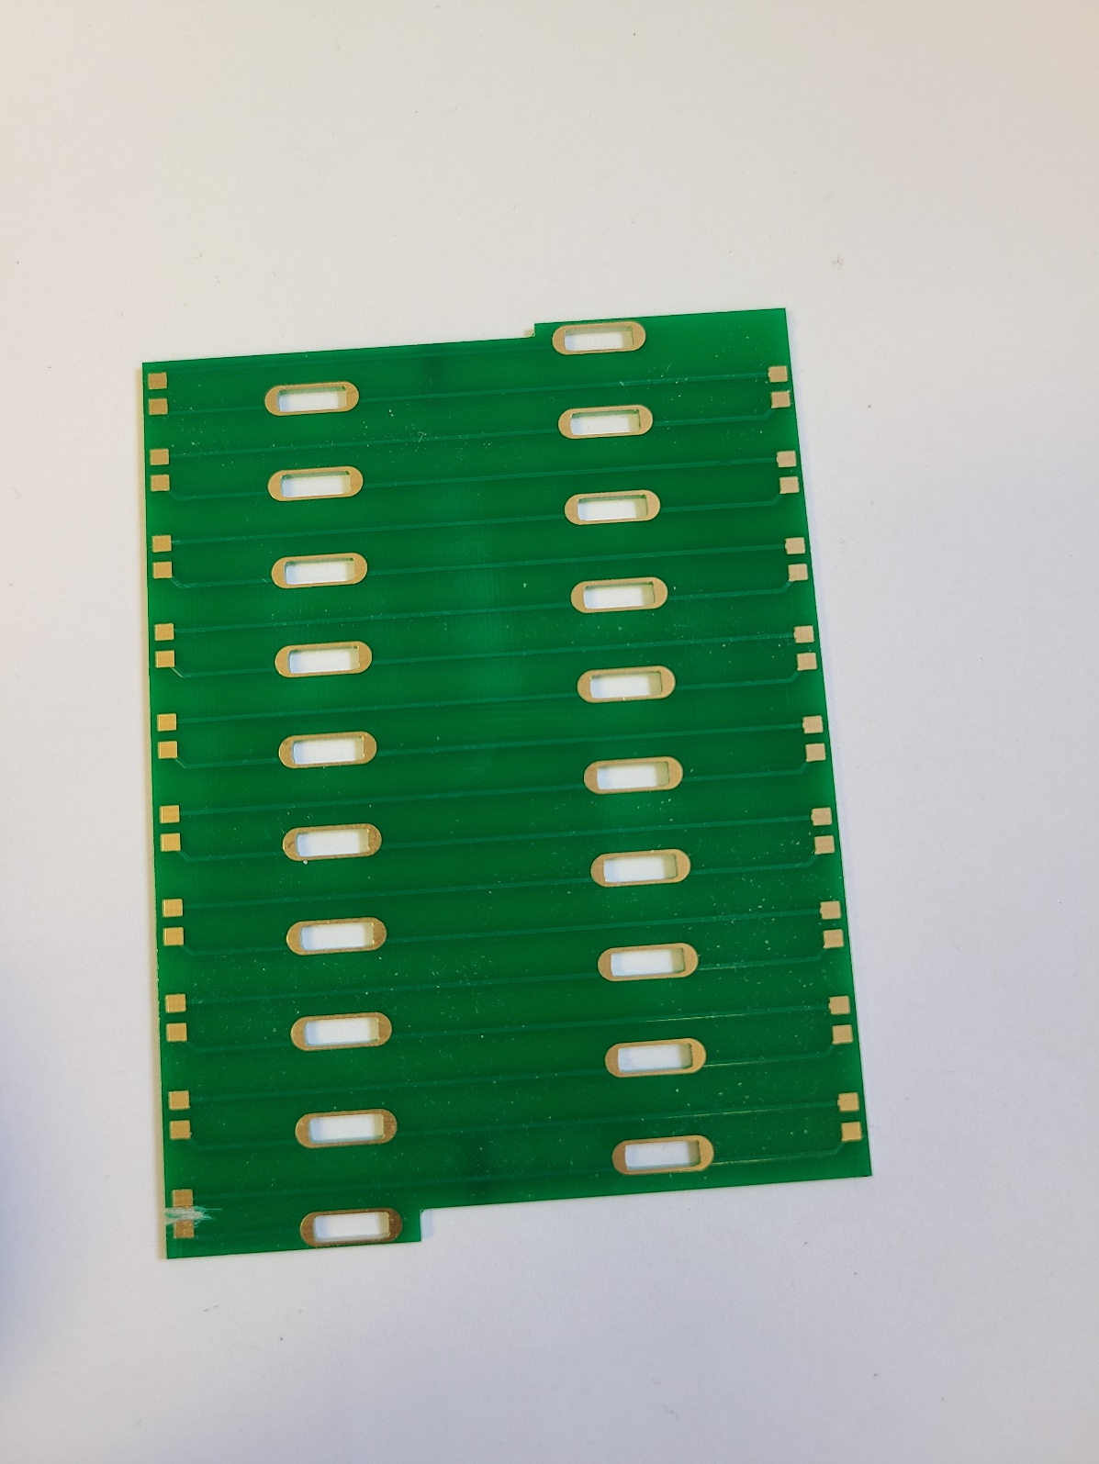
Drift Tube PCB Construction
Resistors are all 250 kΩ
Solder in place and ensure connectivity
PCB boards are bridged with 250 kΩ resistors
Ensure that electrodes are soldered into place cleanly, and that the solder is free of any unwanted solder spikes or burrs.
Each drift region is composed of three top boards and then ONE extra electrode to make connection with the PCB flange via POGO pin

Slide 6
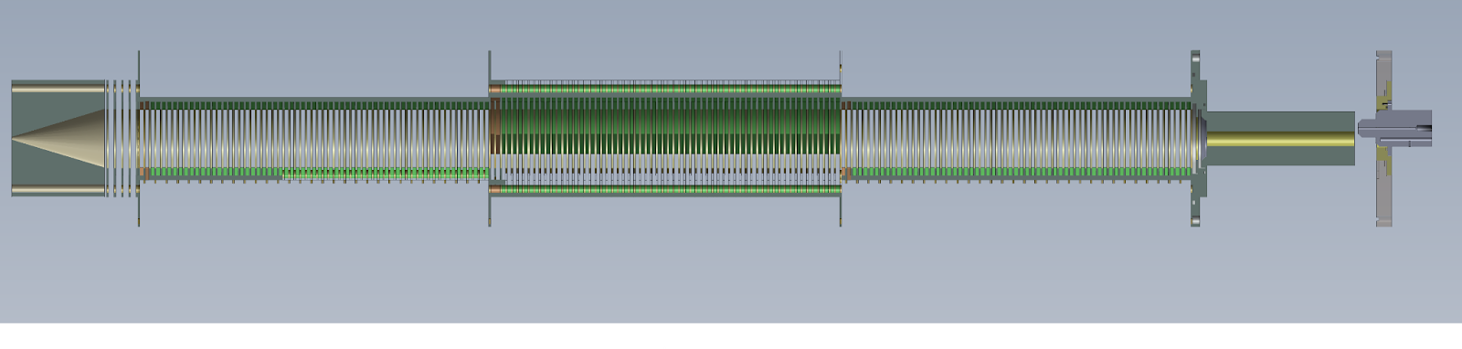
Low-Pressure IMS System
1
2
3
4
5
1. Heated capillary inlet
2. Front ion funnel
3. First drift region
4. End of drift region 4
5. Rear Ion funnel
Ion Shuttle or Faraday plate placed at exit of rear ion funnel

Slide 7
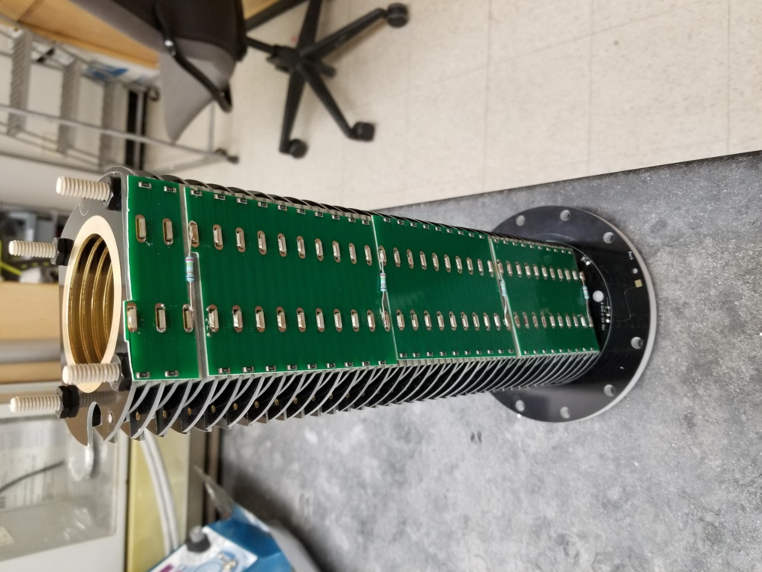
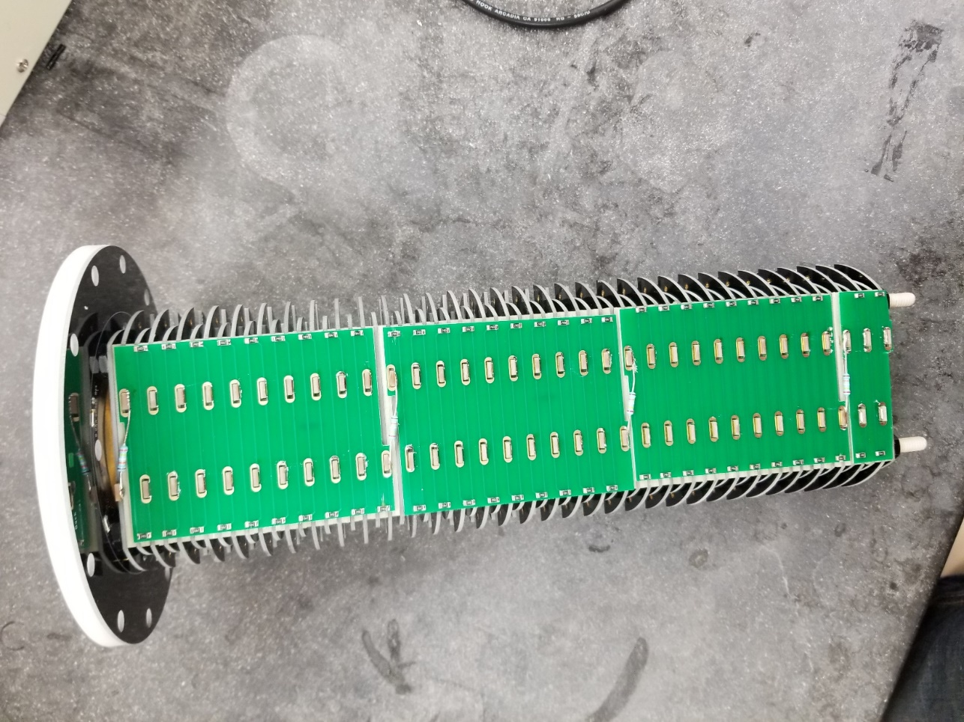
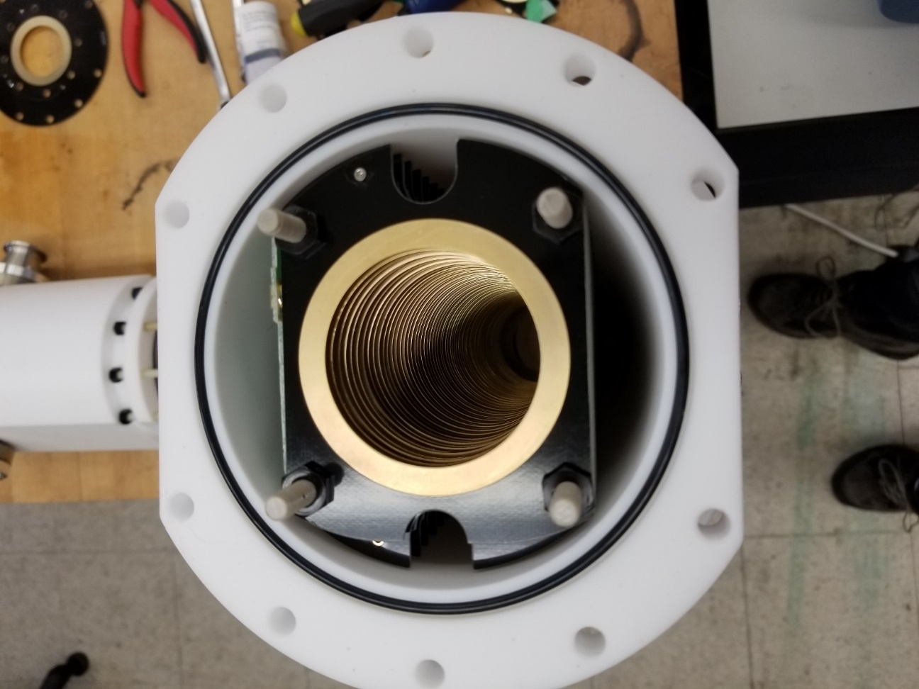
Drift Tube Region 1
The first drift region is distinct because of the mounting plate for utilization with front ion funnel.
Ensure connection with metal ring via POGO pin
Loosen or tighten thin nylon nuts (3mm) after placing electrodes to ensure drift region fits within Teflon chamber

Slide 8
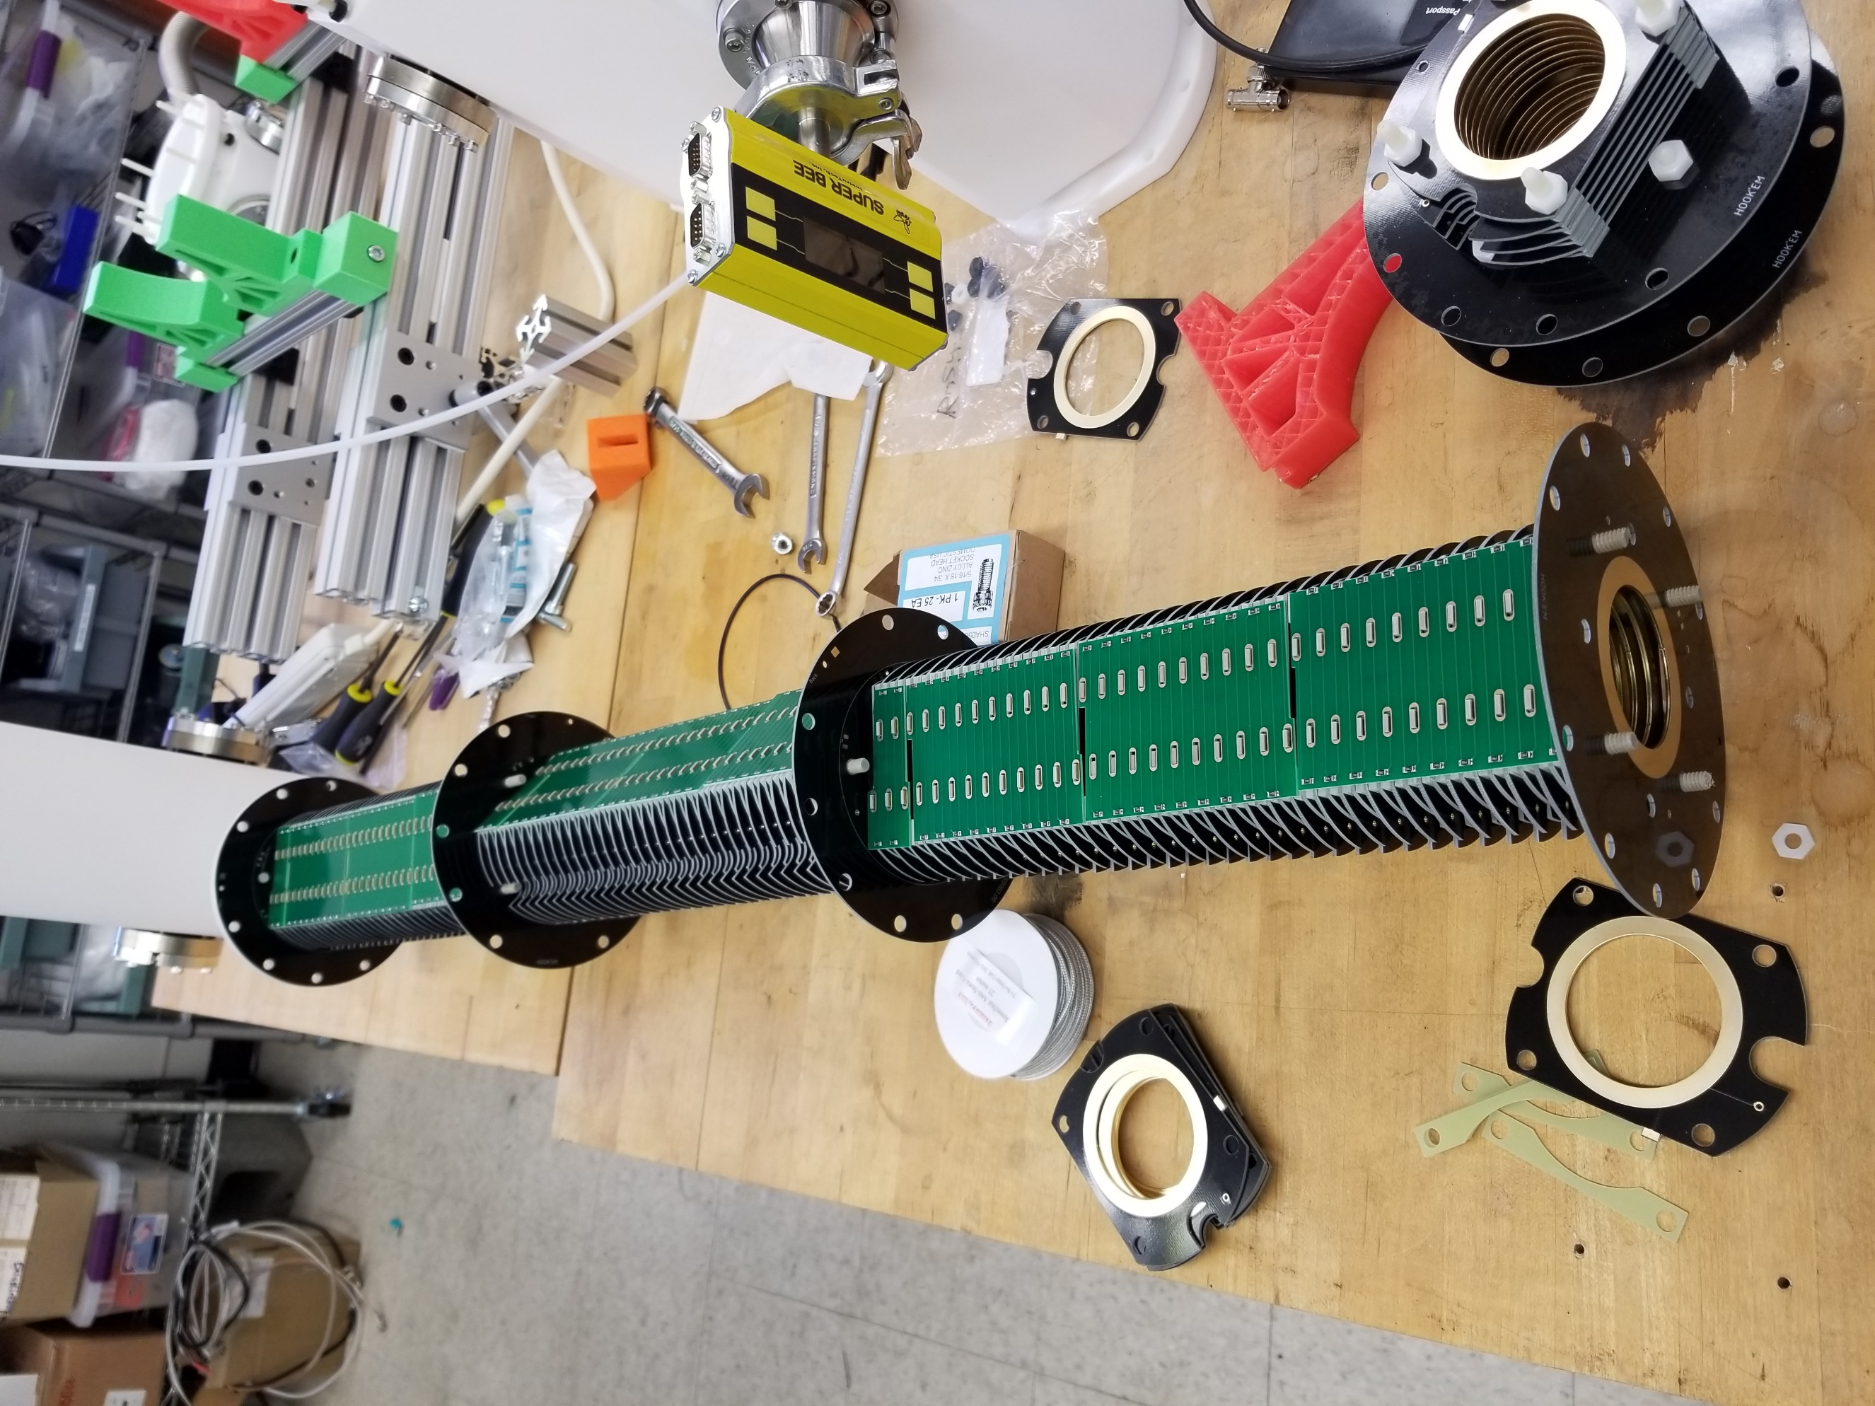
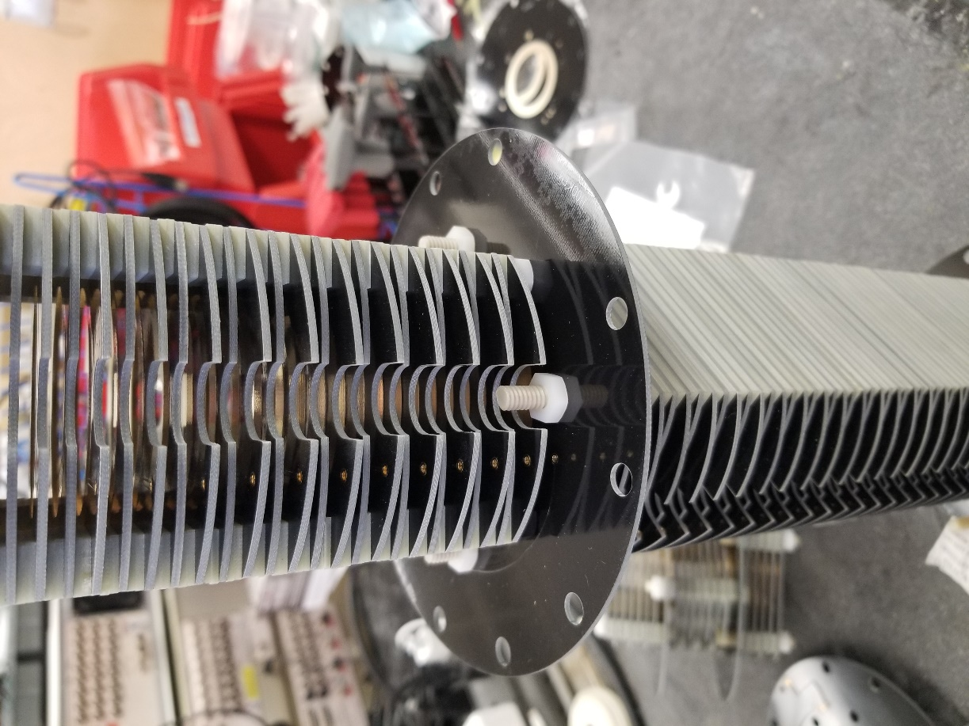
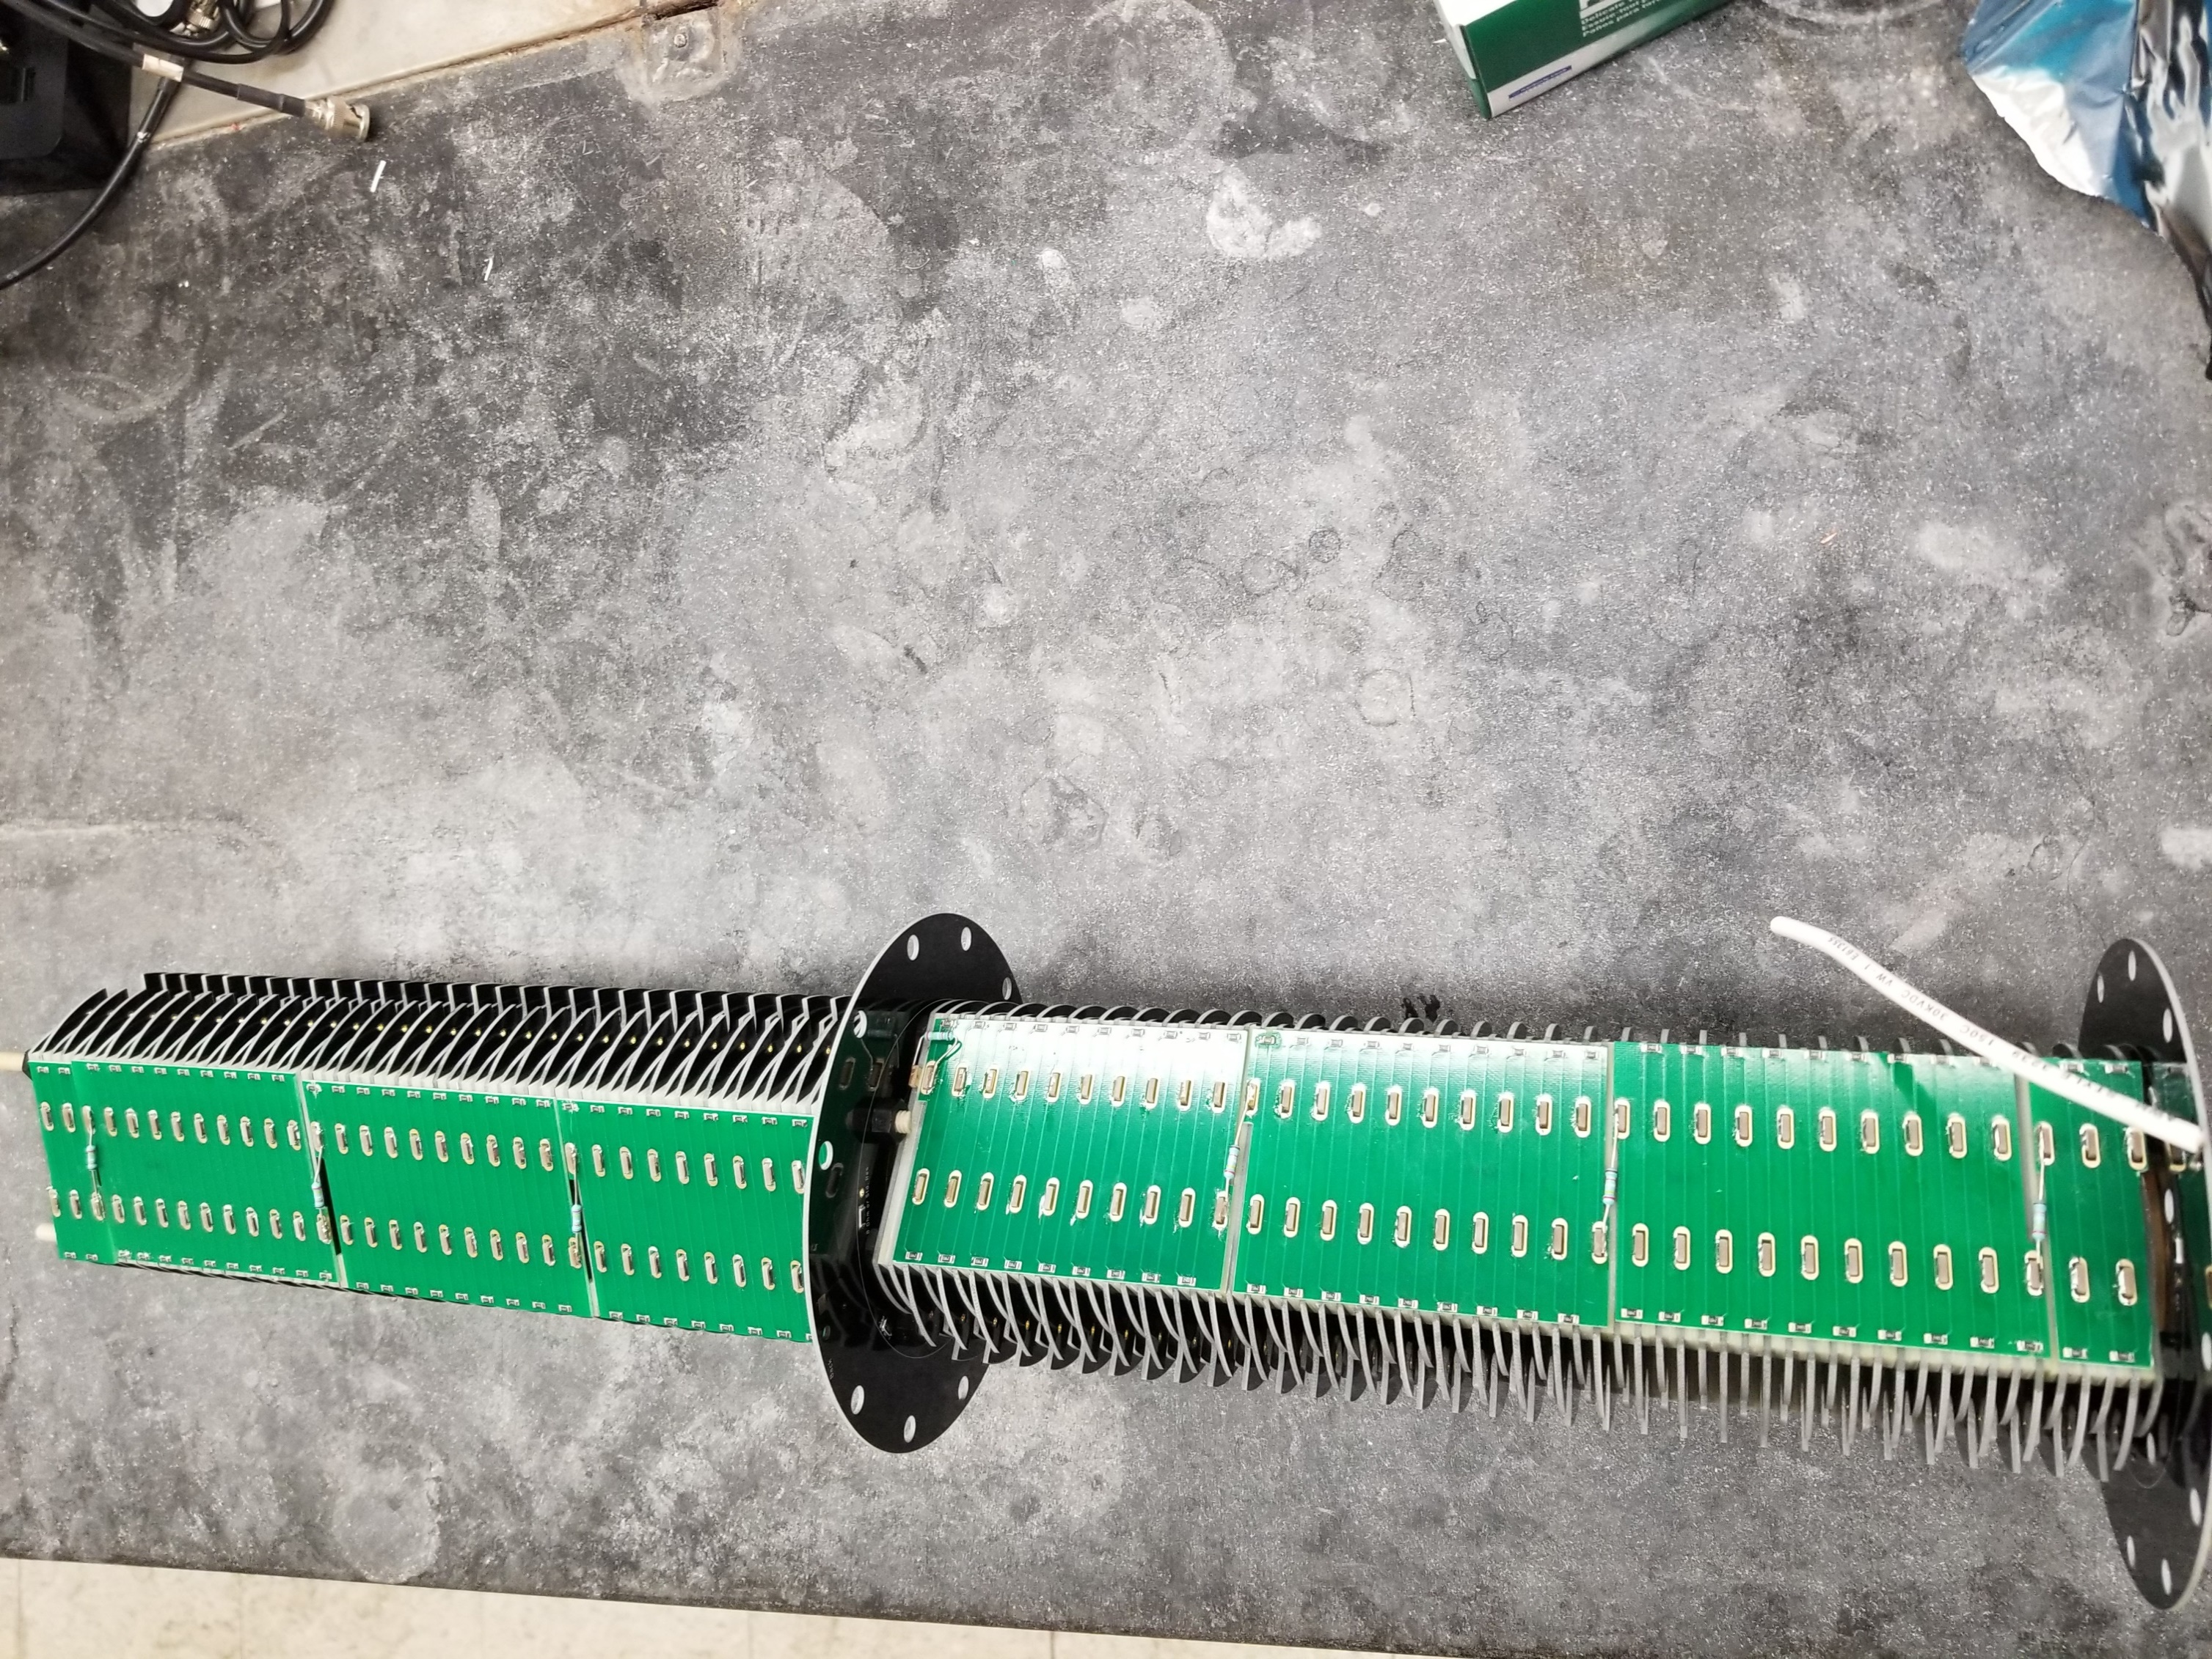
Drift Tube Region 1 to 2
The connection between drift region 1 and drift region 2 is rotated 45 degrees in order to ensure electrical connection
Ensure connection via POGO pins from region 1 to region 2 (Each flange contributes 500 kΩ)
Loosen or tighten thin nylon nuts (3mm) after placing electrodes to ensure drift region fits within Teflon chamber as before
NOTE that there is a deliberate reversal of the LAST electrode of region 2 which is connected via wire resistor. This is to allow for connection via PPOGO pin to the PCB flange

Slide 9

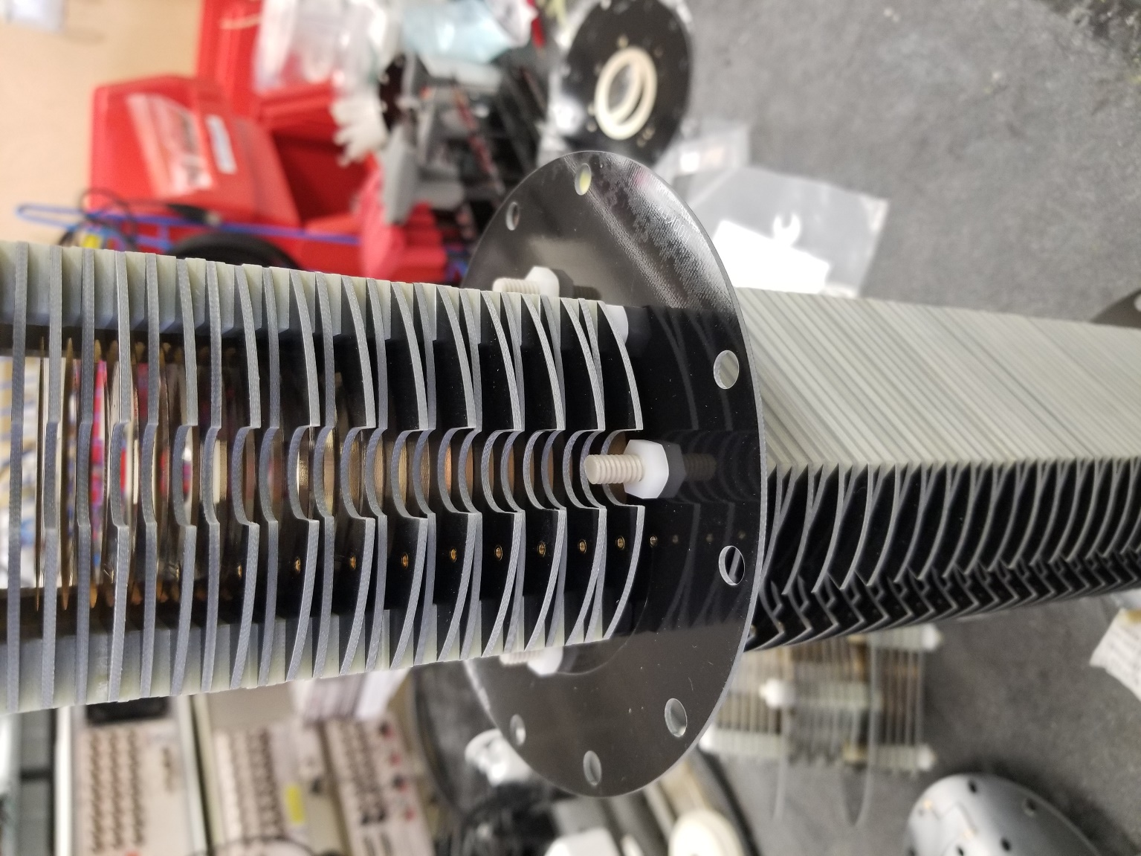
Drift Tube Region 2 to 3
The connection between drift region 2 and drift region 3 is rotated 45 degrees in order to ensure electrical connection (Region 1 and 3 are in same orientation)
Ensure connection via POGO pins from region 2 to region 3 (Each flange contributes 500 kΩ)
Loosen or tighten thin nylon nuts (3mm) after placing electrodes to ensure drift region fits within Teflon chamber as before
NOTE that there is a deliberate reversal of the FIRST electrode of region 3 which is connected via wire resistor to the next electrode. This is to allow for connection via PPOGO pin to the PCB flange

Slide 10
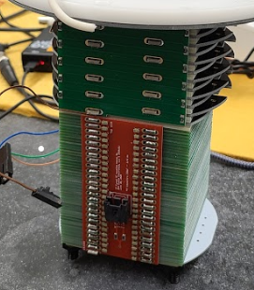
Drift Tube Region 3 to 4
The connection between drift region 3 and drift region 4 is distinct as drift region 4 is directly preceding the rear ion funnel
Ensure connection via POGO pins from region 3 to region 4 (Each flange contributes 500 kΩ)
DC IMS out is connected to last electrode of IMS
The length of drift region 4 is however many electrodes it takes to have the rear ion funnel be flush with the exit of the Teflon chamber
A PCB top board was cut to the correct length using a gravity shear (careful application of wire cutters also works, do not break electrical connection or leave any floating voltages).
Loosen or tighten thin nylon nuts (3mm) after placing electrodes to ensure drift region fits within Teflon chamber as before
Region 4
Region 3

Slide 11
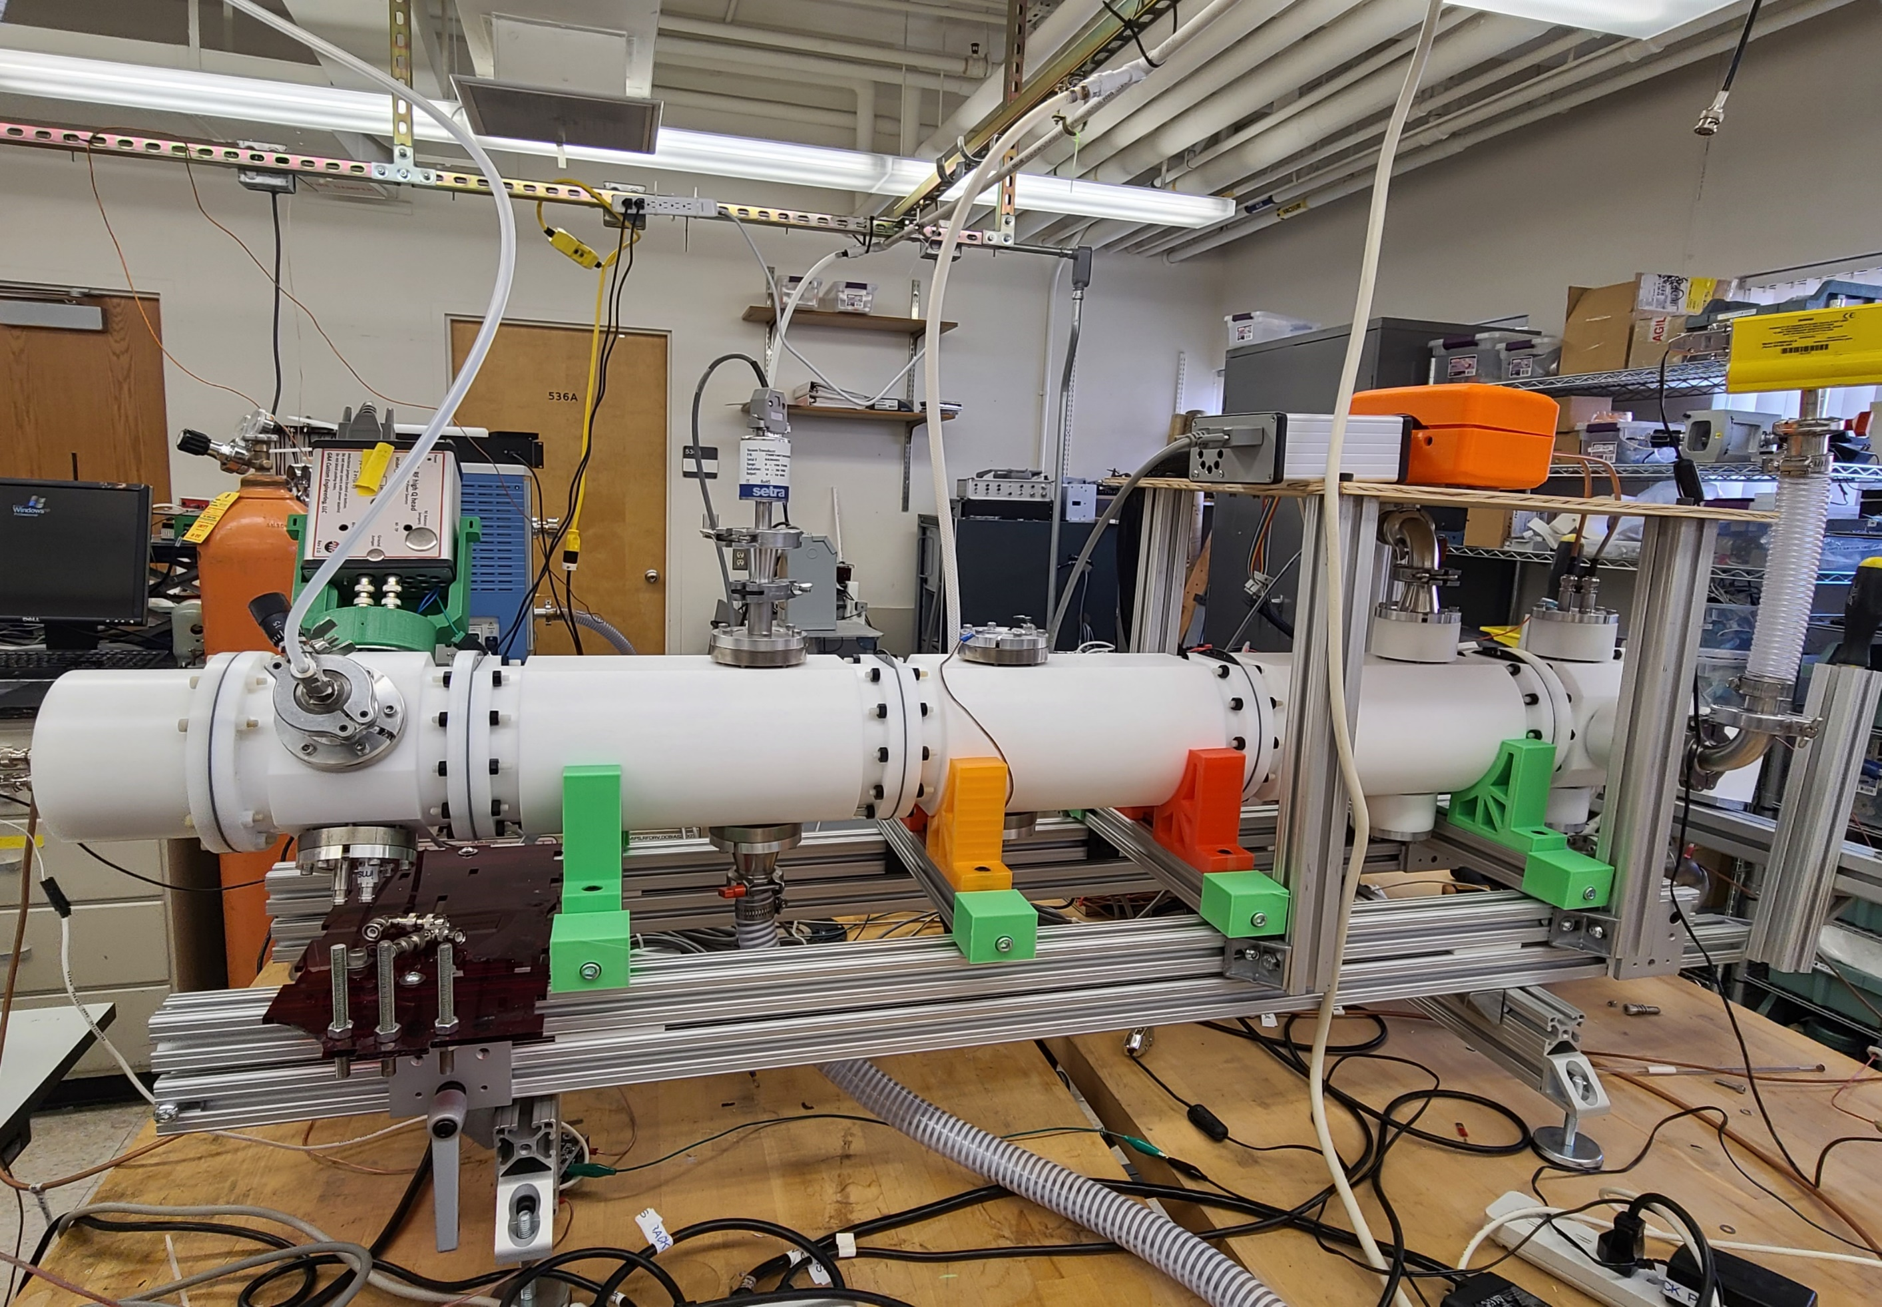
Low-Pressure IMS System
Front Ion Funnel
Start of Drift Region 1
Start of Drift Region 2
Start of Drift Region 3
Start of Drift Region 4
Start of Rear Ion Funnel
Faraday Plate Chamber
Custom support shelf
RF in Front Ion Funnel
DC In Front Funnel
Drift Gas in
RF in Rear Funnel
Pressure Gauges
Vacuum Lines (behind IMS)
13.
13.
12.
8.
13.
9.
1.
2.
3.
11.
4.
5.
7.
10.
6.
14.
14.
Notes:
Front ion funnel is capacitively connected and floated on the drift voltage

Slide 12
Low-Pressure IMS Construction: Drift Region Ion Current Testing
Clowers Research Group at WSU

Slide 13
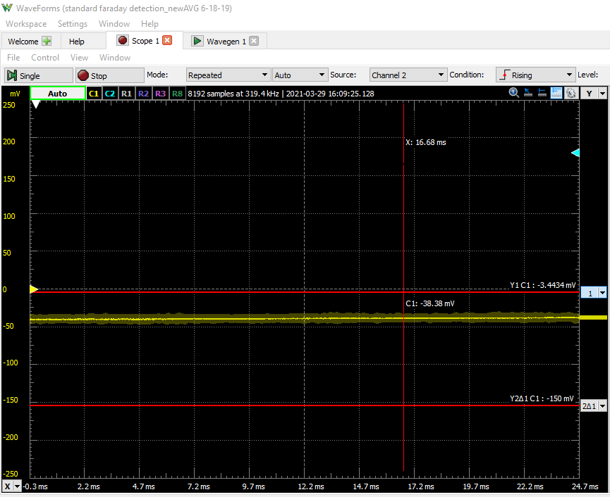
Drift Region ION CURRENT
Before running full system, iteratively test drift region
With both ion funnels in place, add drift region 1 and test for successful ion current.
Front Funnel is capacitivly coupled to drift region 1 voltage
Creative modifications to vacuum lines, pressure gauges, and electrical connections are required to ensure connections and successful operation
Ensure that the front chamber has a slightly higher (~0.1 Torr) than the first drift region chamber or ion current will not be observed.
Same testing parameters as for individual funnel

Slide 14
Drift Region ION CURRENT
Continue to add additional Drift regions until full length system is operational
Creative modifications to vacuum lines, pressure gauges, and electrical connections are required to ensure connections and successful operation
Ensure that the front chamber has a slightly higher (~0.1 Torr) than the first drift region chamber or ion current will not be observed.
Same testing parameters as for individual funnel

Slide 15
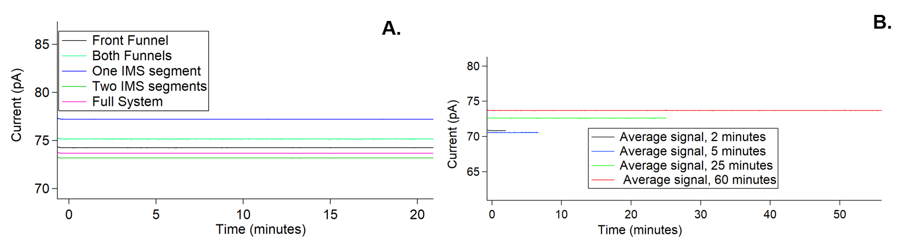
Total Ion Current from Different Configurations
Drift length = Variable
Field strength = 20 V cm⁻¹
Pressure = ~4 ± 10% Torr
Temperature = 300.5 K
If the same solution is used for all ion current measurements, observed values should be in close agreement

Slide 16
Stability of Total Ion Current
Drift length = ~104 cm
Field strength = 20 V cm⁻¹
Pressure = ~4 ± 10% Torr
Temperature = 297 K
To ensure that the system is not charging, measure total ion current at different time increments (signal averaged)
The longest time increment should have approximately same signal as the shortest. If it is significantly higher, system is building charge

Slide 17
Low-Pressure IMS Construction: Charging Concerns
Clowers Research Group at WSU

Slide 18
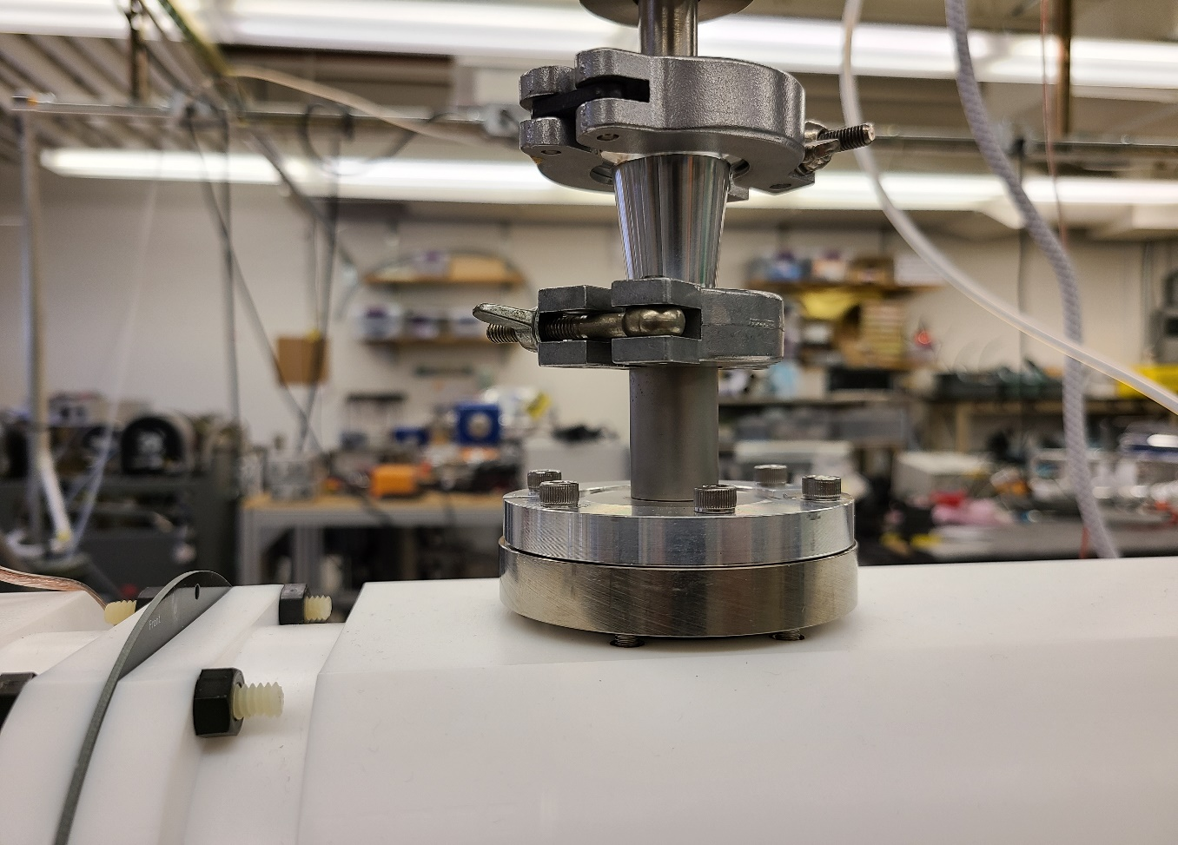
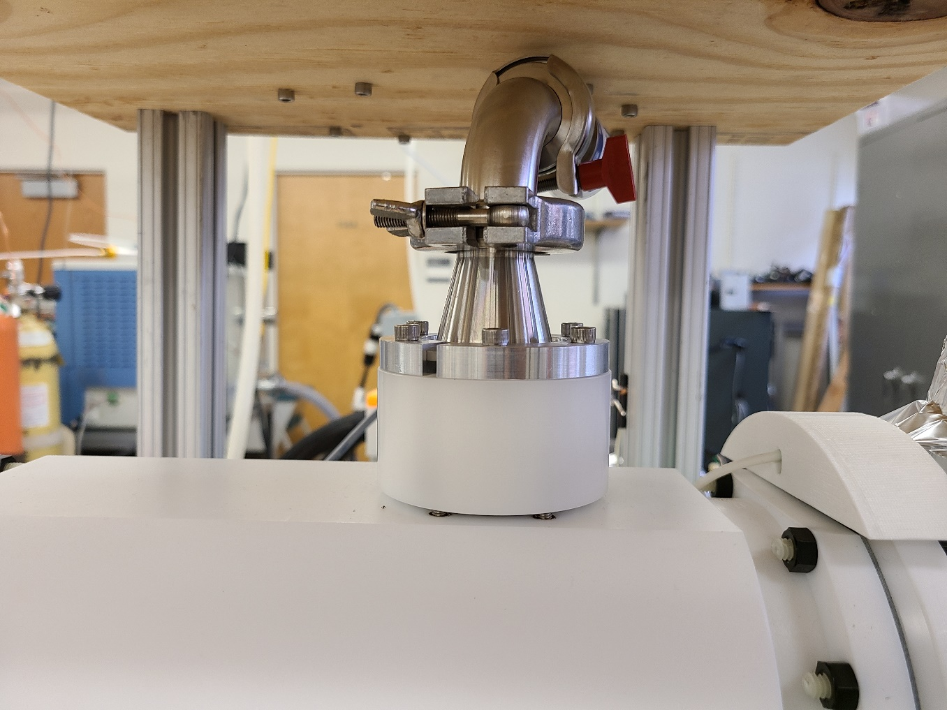
Electrical Discharge Management
Before addition of these custom Delrin spacers, arcing would occur when trying to bring system up to operational voltage
Delrin spacers were added on all 6 locations for the front funnel chamber (4 locations) and the first drift region (2 locations) to prevent electrical discharge

Slide 19
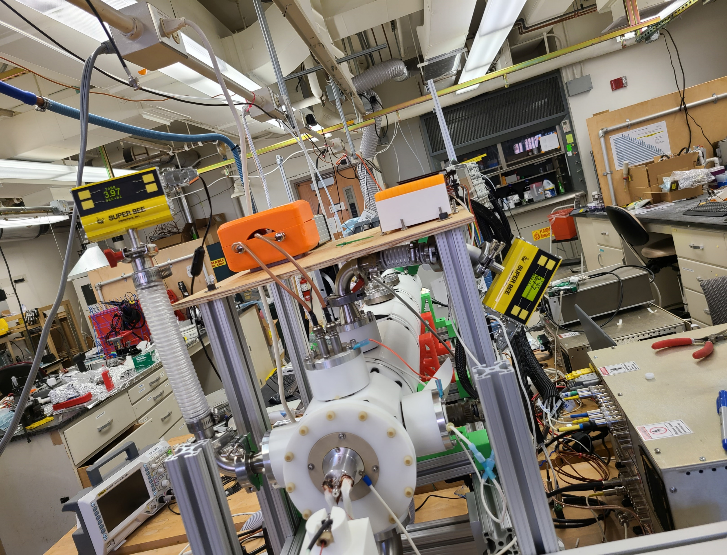
Electrical Discharge Management
The KF 40 plates for the RF in and DC in of the front ion funnel both need to be electrically connected in order to prevent arcing
The voltage applied to the drift region also needs to be connected to the KF 40 inlet for DC in of the front funnel to prevent arcing

